Slide 1
AIR QUALITY PREDICTION
presented by under the guidance of
m. Harsha Vardhan Chary d. Ramesh
2203a52162 ASst prof (Cse ai & ml)

Slide 2
content
PROBLEM STATEMENT
INTRODUCTION
IMPLEMENTATION
RESULT & COMPARISION
CONCLUSION

Slide 3

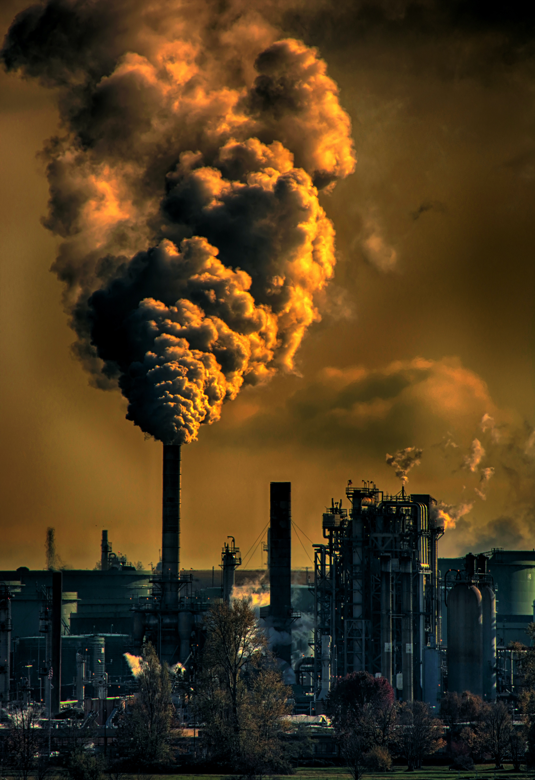
PROBLEM STATEMENT
The problem is to develop a predictive model for air quality based on the provided dataset. Develop a predictive model using historical air quality data, including CO, NO, NO2, O3, SO2, PM2.5, PM10, and NH3 measurements. The aim is to forecast future air quality parameters based on past records, enabling vital insights for public health, environmental protection, and urban planning.

Slide 4
introduction
This dataset presents a comprehensive historical record of air quality measurements, encompassing essential parameters such as carbon monoxide (CO), nitrogen oxides (NO and NO2), ozone (O3), sulfur dioxide (SO2), fine particulate matter (PM2.5), coarse particulate matter (PM10), and ammonia (NH3). Covering a diverse range of timestamps, it offers valuable insights into air quality variations over time. The dataset's primary purpose is to facilitate the development of predictive models for forecasting air quality parameters, which holds critical significance for public health, environmental monitoring, and urban planning.

Slide 5
implementation
Linear Regression:
1.Data Collection: Gather a dataset containing the dependent variable (target) and one or more independent variables
2.Data Preprocessing: Clean and preprocess the data by handling missing values, outliers, and scaling if necessary. 3.Split Data: Divide the dataset into training and testing subsets to evaluate the model's performance.
4. Choose a Model: Select the appropriate type of linear regression based on the problem (e.g., simple linear regression for one feature or multiple linear regression for multiple features).
5.Model Training: Fit the linear regression model to the training data by finding the coefficients that minimize the error (usually using the least squares method).
6.Model Evaluation: Assess the model's performance using evaluation metrics such as Mean Squared Error (MSE) or R-squared on the test data.
7. Make Predictions : Use the trained model to make predictions on new or unseen data.
8.Interpret Results: Analyze the coefficients to understand the impact of each independent variable on the dependent variable.).
Linear regression is a fundamental technique in machine learning and statistics used for both simple and complex predictive modeling tasks.

Slide 6
SUPPORT Vector MAChine
1.Data Collection: Gather a labeled dataset with features and corresponding class labels.
2. Data Preprocessing : Clean and preprocess the data, which may include feature scaling and handling missing values.
3. Split Data: Divide the dataset into training and testing sets to evaluate the model's performance.
4. Select SVM Type: Choose the appropriate SVM type based on the problem: linear SVM for linearly separable data or kernel SVM for non-linear data.
5. Model Training: Train the SVM by finding the optimal hyperplane (or non-linear boundary) that maximizes the margin between classes while minimizing classification errors.
6. Hyperparameter Tuning: Adjust hyperparameters like the regularization parameter (C) or kernel type to fine-tune the model's performance.
7. Model Evaluation: Assess the model's performance using metrics like accuracy, precision, recall, F1-score, or ROC curves on the test data.
9. Make Predictions**: Use the trained SVM to classify new or unseen data points.
10. Interpret Results**: Analyze support vectors and decision boundaries to gain insights into the model's classification decisions.

Slide 7
Lasso Regression
1. dataset with predictor variables and a target variable.
2. Choose Lasso regression as your model, adding an L1 regularization term.
3. Split the data into training and testing sets.
4. Select the regularization parameter (λ) using cross-validation.
5. Train the Lasso model, make predictions, evaluate performance, and analyze the coefficients for feature selection.

Slide 8
ridge regression
1. dataset with predictor variables and a target variable.
2. Choose Ridge regression as your model, adding an L2 regularization term.
3. Split the data into training and testing sets.
4. Select the regularization parameter (λ) using cross-validation.
5. Train the Ridge model, make predictions, evaluate performance, and analyze the coefficients for feature balance.

Slide 9
Knn regression
1. dataset with predictor variables and a target variable.
2. Choose the number of neighbors (k) for the k-NN algorithm.
3. Split the data into a training set and a testing set.
4. For each data point in the testing set, find the k nearest neighbors from the training set based on a distance metric (e.g., Euclidean distance).
5. Predict the target variable by averaging or weighting the target values of the k nearest neighbors, and evaluate the model's performance.

Slide 10

Target Variable
The target variable "CO" in the provided dataset most likely represents the concentration of Carbon Monoxide (CO) in the air. Carbon Monoxide is a colorless, odorless gas that can be harmful to both the environment and human health when present in high concentrations. It is a common air pollutant produced by the incomplete combustion of fossil fuels, such as gasoline and natural gas.

Slide 11
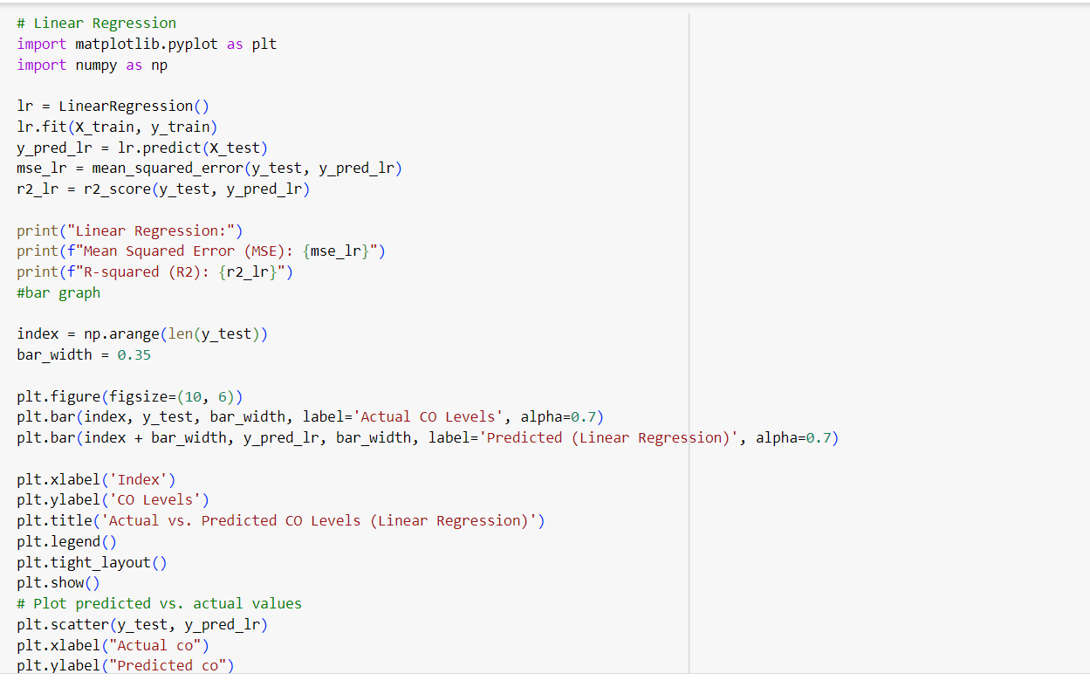
Linear Regression

Slide 12
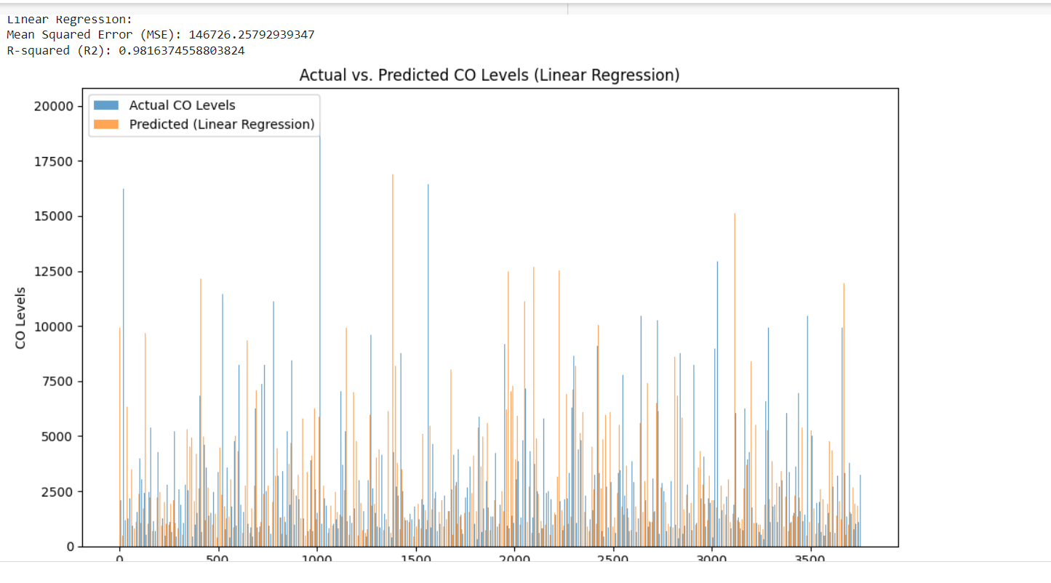
Linear regression Output

Slide 13
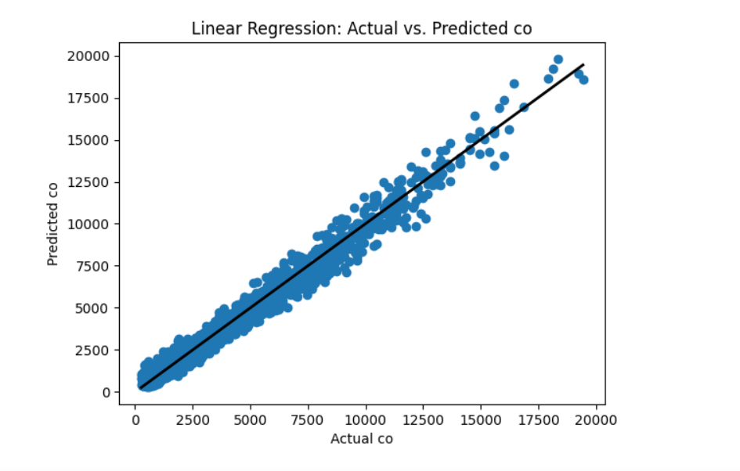
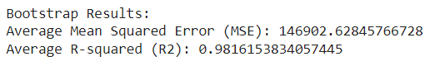
Linear Regression Output

Slide 14
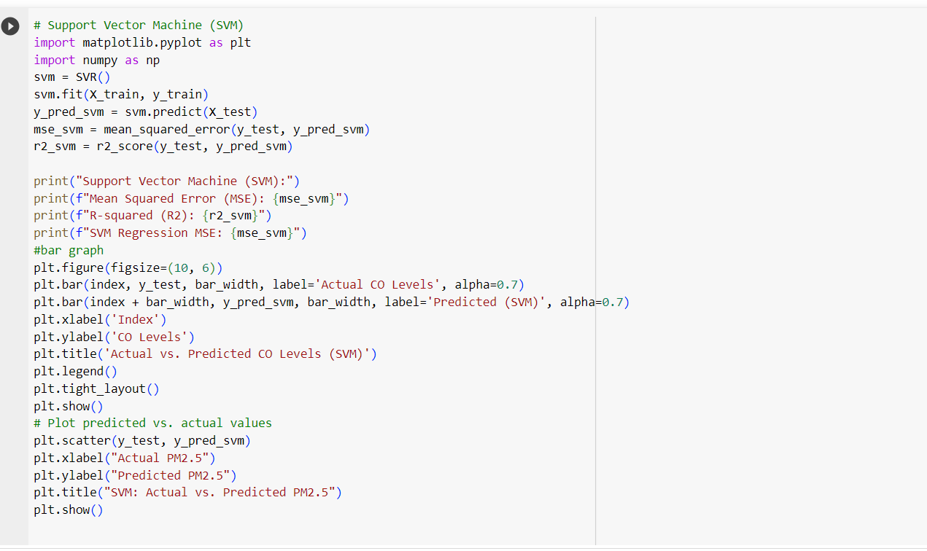
Support vector machine

Slide 15
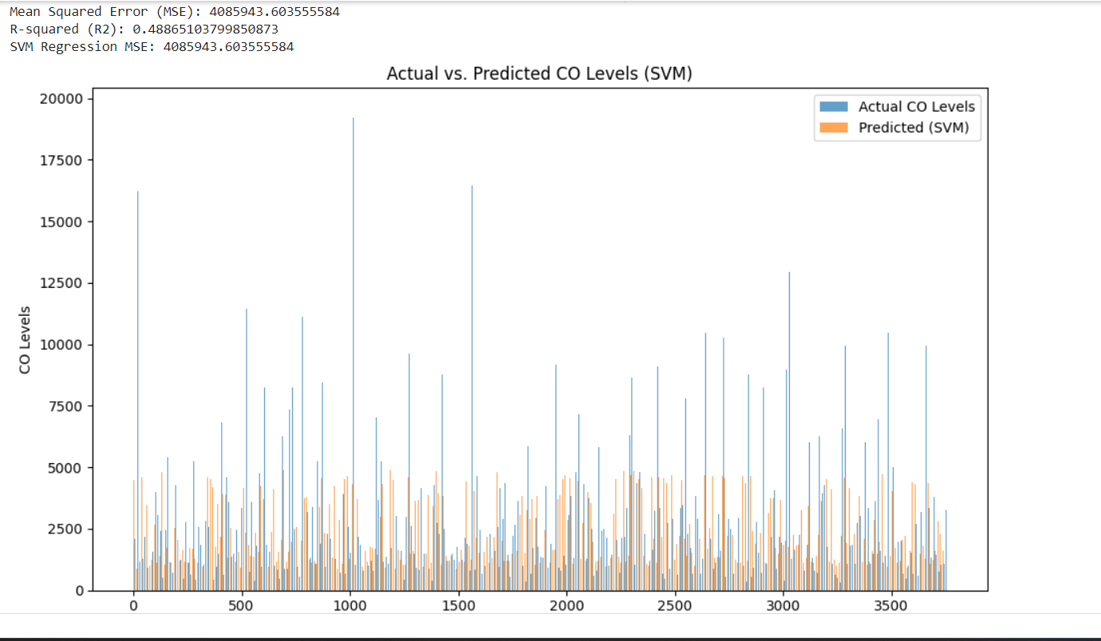
SVM OUTPUt

Slide 16
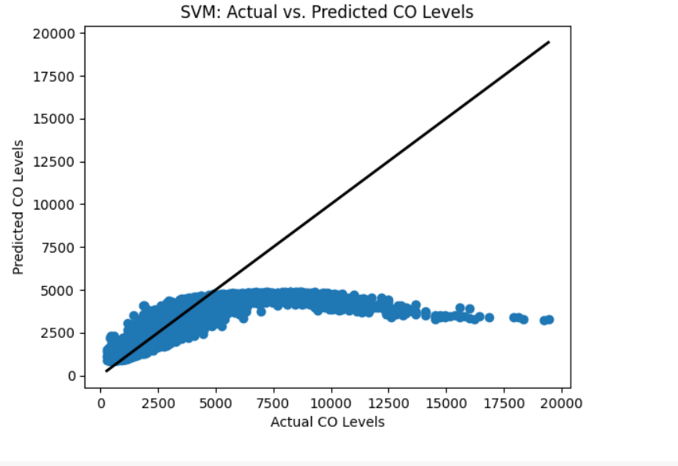
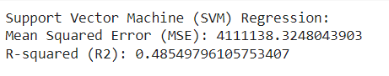
SVM OUTput

Slide 17
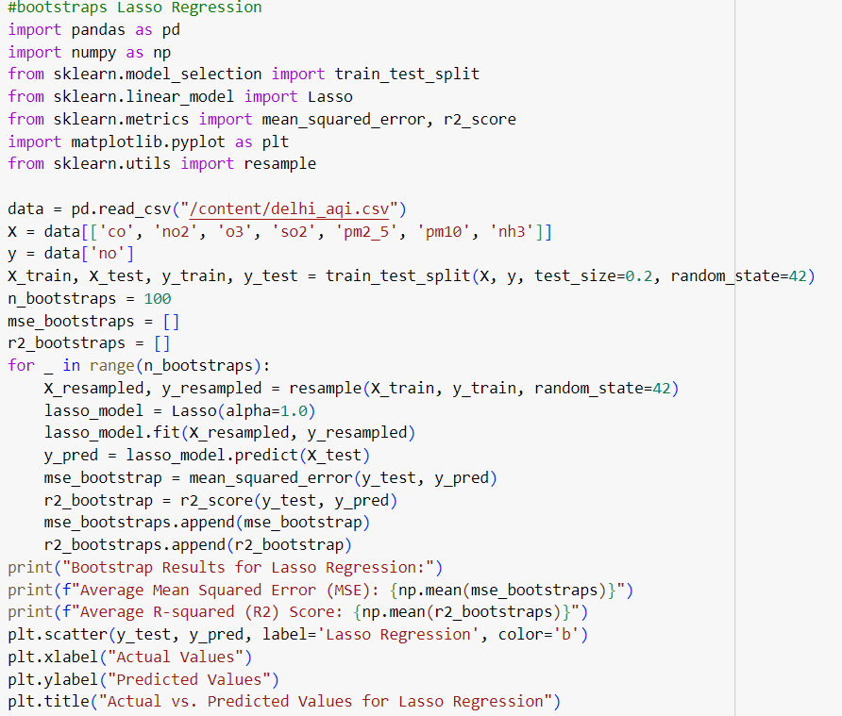
Lasso Regression

Slide 18
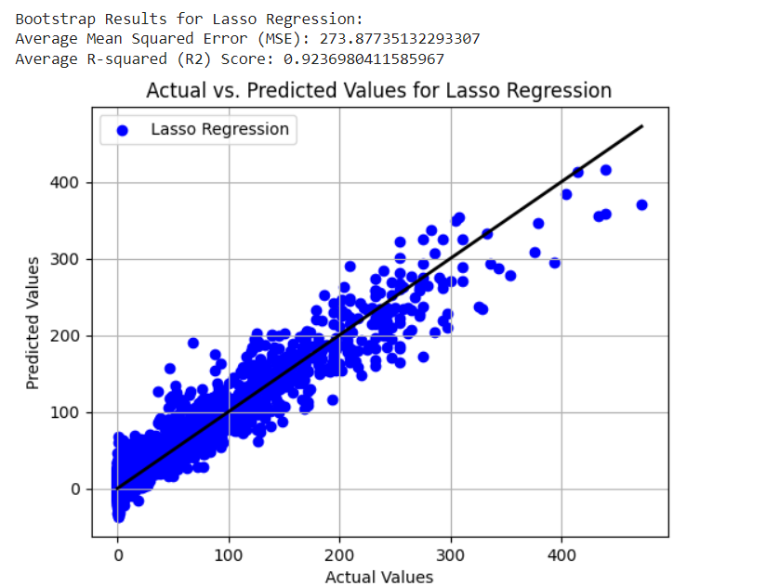
Lasso regression output

Slide 19
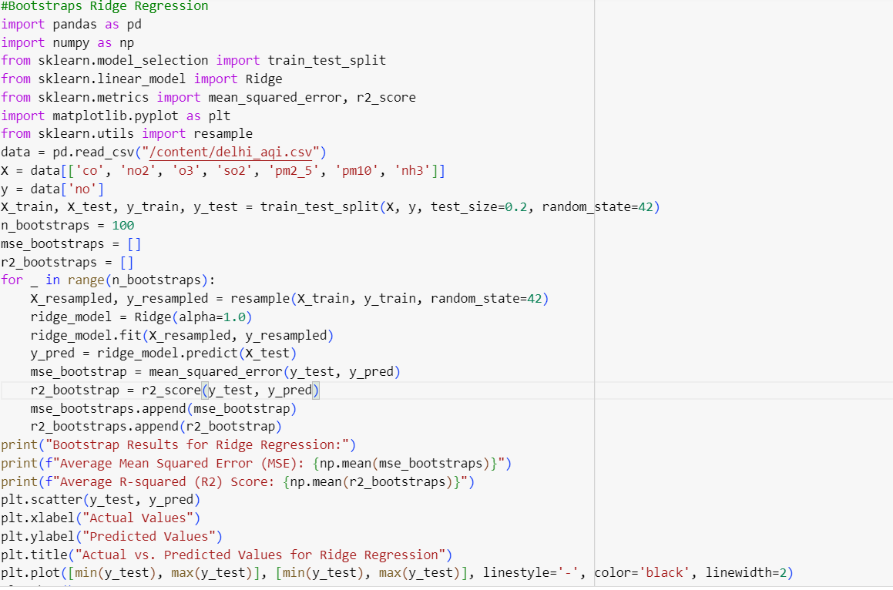
Ridge regression

Slide 20
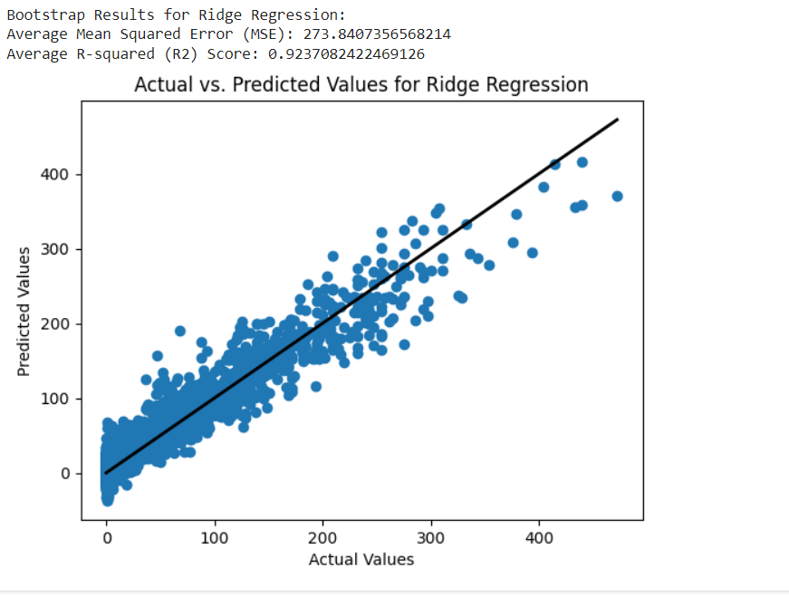
Ridge regression output

Slide 21
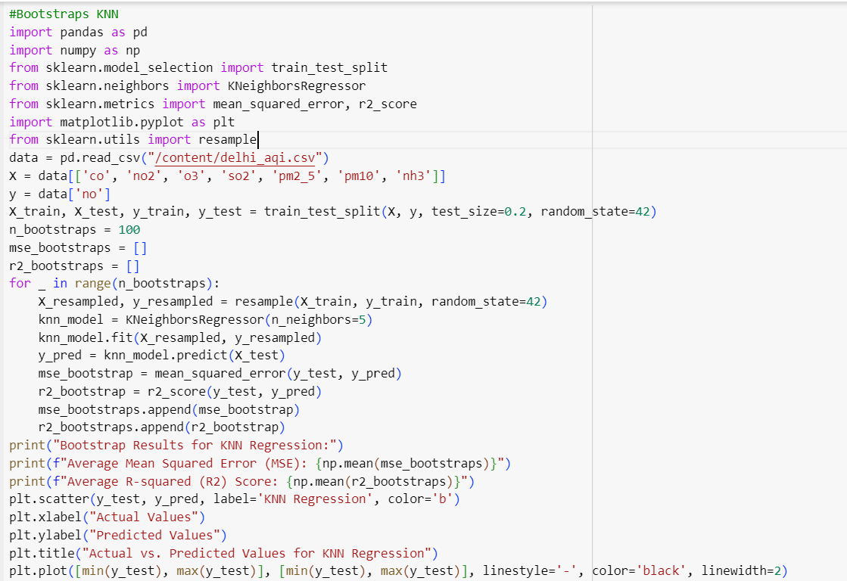
Knn regression

Slide 22
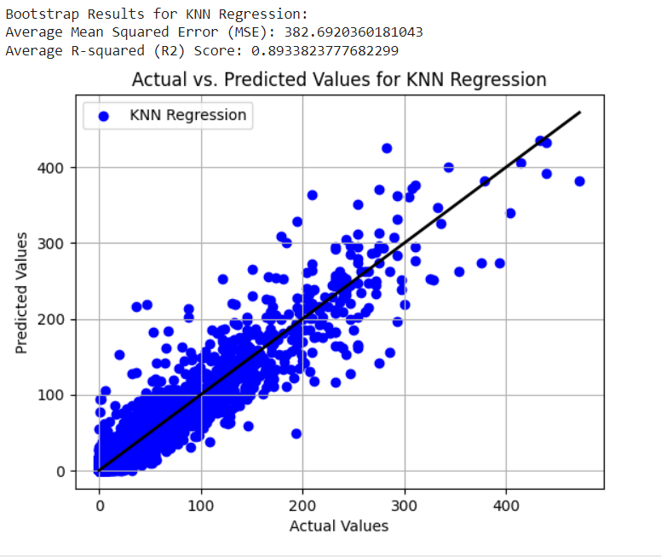
Knn regression output

Slide 23
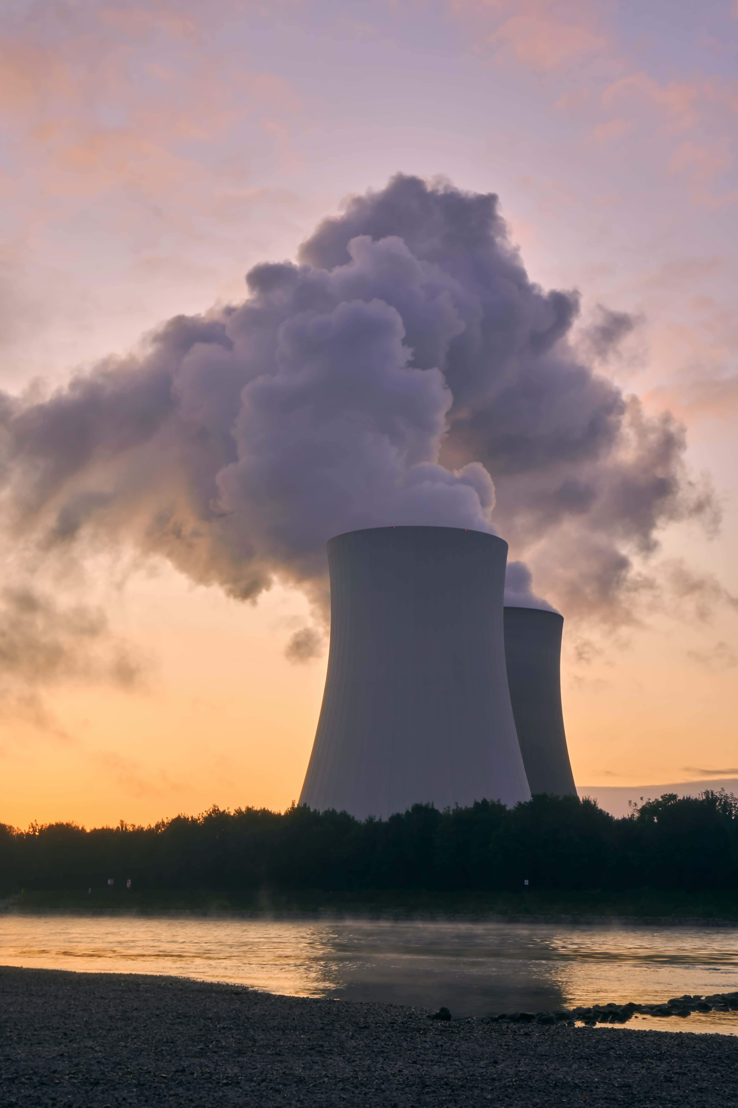
Conclusion:
The "CO" variable in the dataset likely represents Carbon Monoxide levels in the air, a critical parameter for assessing air quality. Monitoring CO is essential for environmental and public health reasons, as it helps identify pollution sources and potential health risks. Accurate CO data enables policymakers and environmentalists to implement strategies for reducing emissions and improving overall air quality, ultimately contributing to a healthier and more sustainable environment.

Slide 24

Github Link
https://github.com/harshavardhan2227/Air_Quality_Prediction.git

